Slide 1
Kaggle训练营

Slide 2
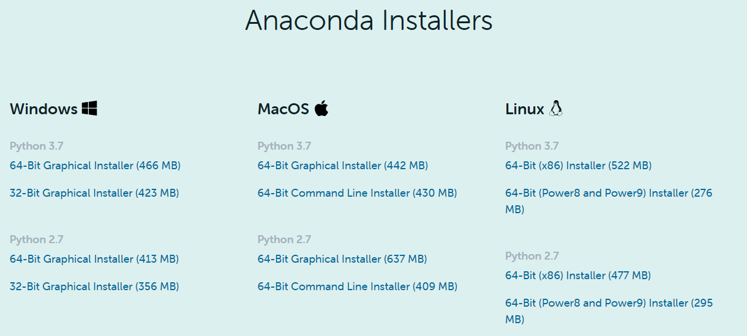
Python Installation
Download: Anaconda Python 3.7 64-bits
Link: https://www.anaconda.com/products/individual
Choose the version consistent with the system (Windows or Mac) of your computer, and download.
Install Anaconda to your local drive

Slide 3
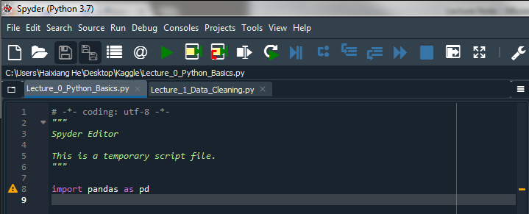
Preferred IDE – Spyder
You will find it under anaconda folder

Slide 4
Project: House Prices: Advanced Regression Techniques
Link: https://www.kaggle.com/c/house-prices-advanced-regression-techniques/overview/description
Objective: This competition challenges you to predict the final price of each home, with 79 explanatory variables describing (almost) every aspect of residential homes in Ames, Iowa.
Goal: Submissions are evaluated on Root-Mean-Squared-Error (RMSE) between the logarithm of the predicted value and the logarithm of the observed sales price.
Create your own Kaggle account

Slide 5
Python Basics
If you are new to Python, read and run the Python code of Lecture_0: Python_Basics.
Don’t worry about to much detail of the Numpy or Pandas functions. When you have troubles during the project, stockoverflow.com is always your best friend.

